Slide 1

Synod 2021-2023
Facilitator Training
Diocese of Saginaw
Questions can be sent to:
Don Buchalski
dbuchalski@dioceseofsaginaw.org
(989) 797-6650

Slide 2
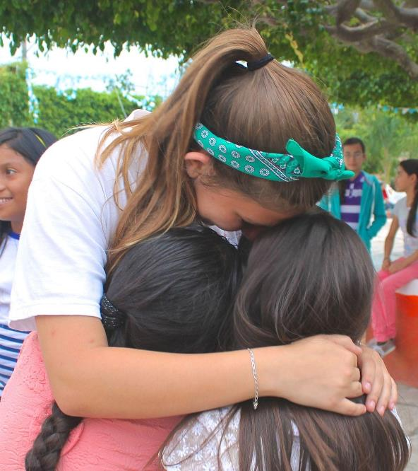
Agenda
Welcome and Opening Prayer
Introduction to the Synod
Overview of Listening Session
Ground Rules
Small Group Discussion
Large Group Feedback & Evaluation
Closing Prayer

Slide 3
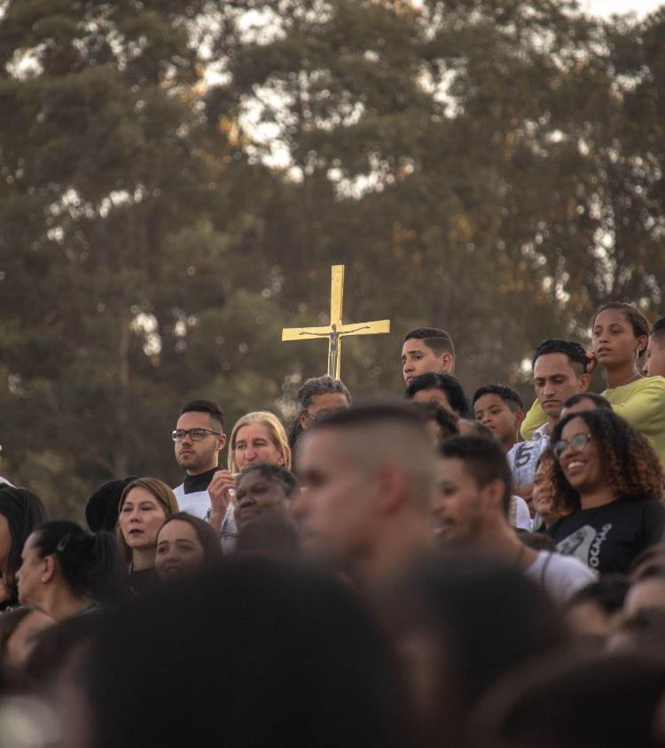
Opening Prayer
Prayer for the Synod
We stand before You, Holy Spirit,
as we gather together in Your name.
With You alone to guide us,
make Yourself at home in our hearts;
Teach us the way we must go
and how we are to pursue it.
We are weak and sinful;
do not let us promote disorder.
Do not let ignorance lead us down the wrong path
nor partiality influence our actions.
Let us find in You our unity
so that we may journey together to eternal life
and not stray from the way of truth
and what is right.
All this we ask of You,
who are at work in every place and time,
in the communion of the Father and the Son,
forever and ever. Amen.

Slide 4
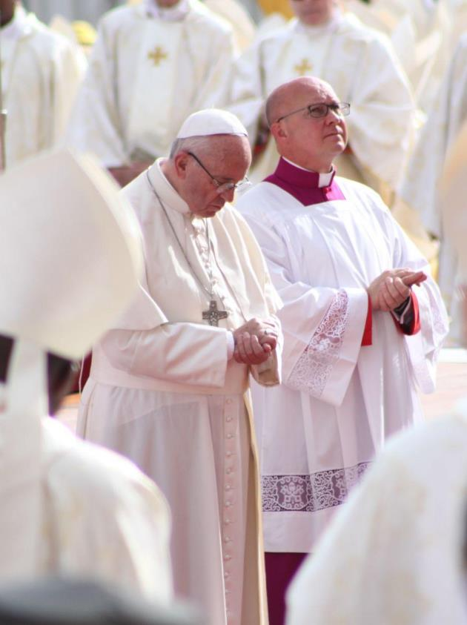
Introduction to the Synod
Pope Francis has called the entire People of God to journey together! This Synod is not just another meeting with oral presentations and written reports. This Synod is a process of journeying together by listening, dialoguing, praying, discerning, and making decisions together for the purpose of proclaiming the Gospel of Jesus Christ.
Synod on Synodality
Notes:
Use my script from previous meetings

Slide 5
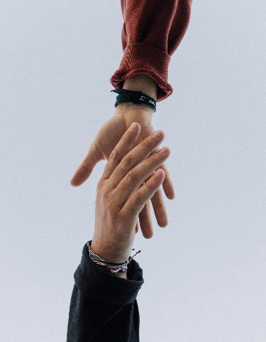
Resources Available
https://www.saginaw.org/resources-parishes-and-parishioners
Toolkit
Facilitators Guide
Synod Conversations Note
Participants Guide
Additional information:
  Vatican Synod website https://www.synod.va/en.html
  USCCB Synod website https://www.usccb.org/synod
  Saginaw Diocese Synod website https://www.saginaw.org/synod2023

Slide 6
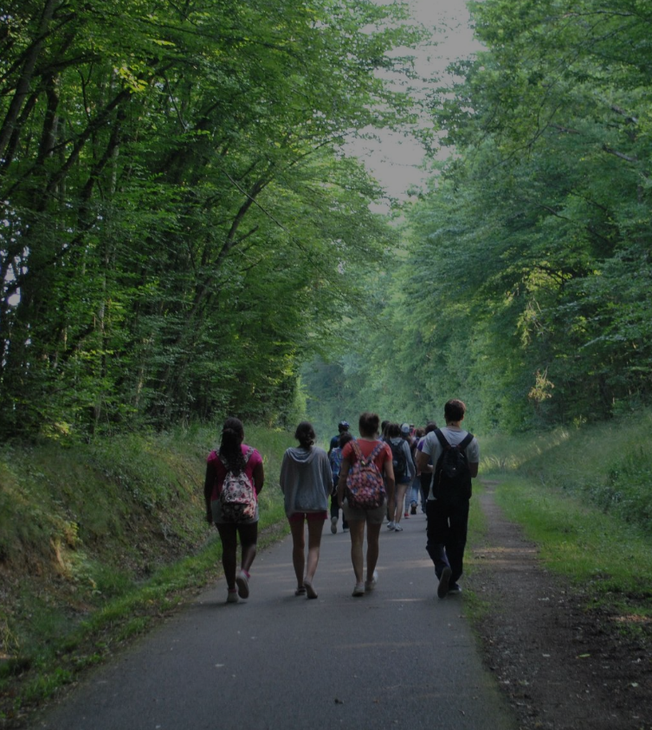
Overview of Listening Session

Slide 7
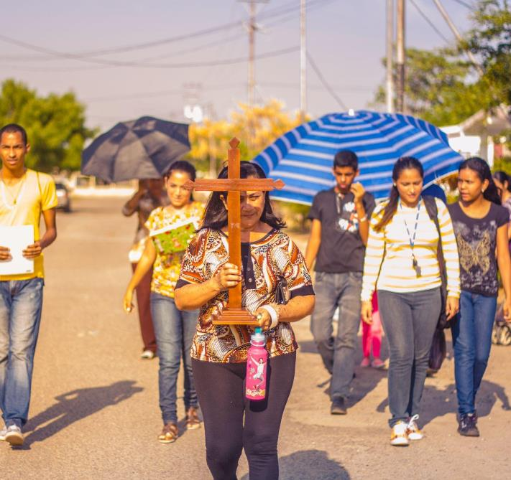
Ground Rules
We are here today to have a DIALOGUE or a conversation to build relationships and exchange perspectives between participants.
We want to expand our possibilities by helping to reflect on our collective experiences.
Please avoid arguing or comments that seek to advance a personal agenda.
We will treat what anyone says with reverence and respect.
During individual sharing, one person speaks at a time, uninterrupted.
We will listen with an open mind.
We only speak once until everyone has had an opportunity to share.
Respect the times of silence when we stop the sharing to reflect and pray.
When we report themes and experiences it will be done without attributing specific comments to individual participants.

Slide 8
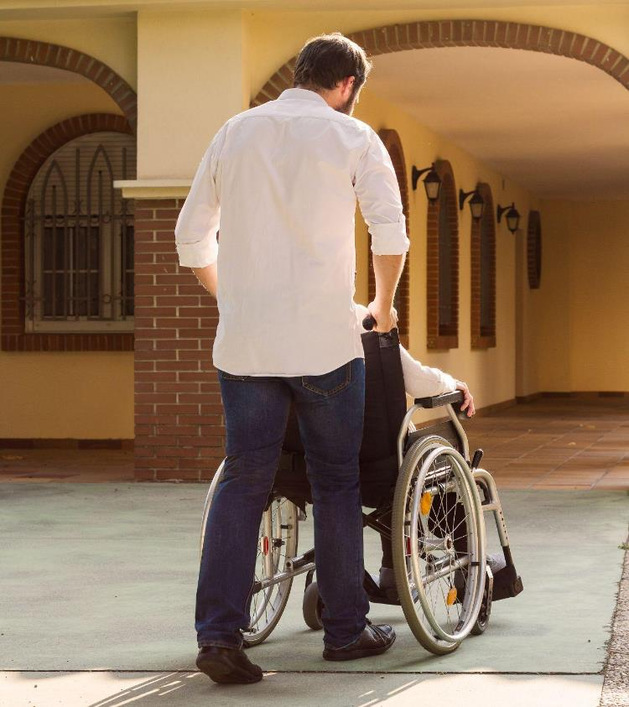
Small Group Discussion
Round #1
Individual Sharing
Faith sharing experiences
  Growth and joys
  Difficulties, obstacles, and wounds
Fundamental question and thematic reflections

Slide 9
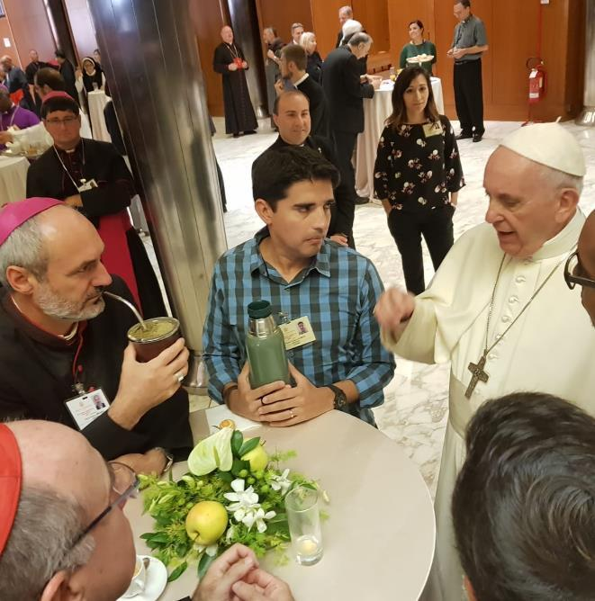
Small Group Discussion
Round #2
Individual reflection on insights
What does our parish do well we need to continue doing?
What can our parish do better?
What other voices do we need to listen to who are not being heard?

Slide 10
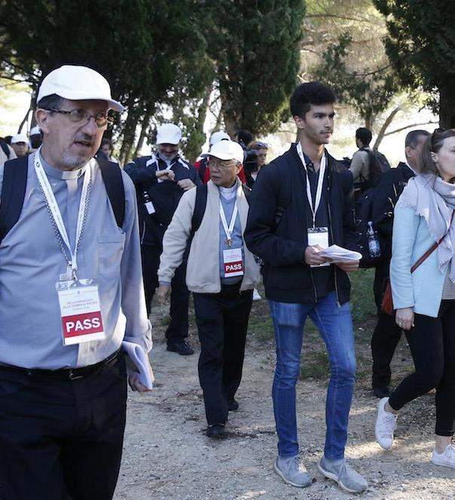
Small Group Discussion Group Discernment
Moving to from a DIALOGUE to a DISCUSSION.
Key Messages
Minority Opinions
Listening Session Experience

Slide 11
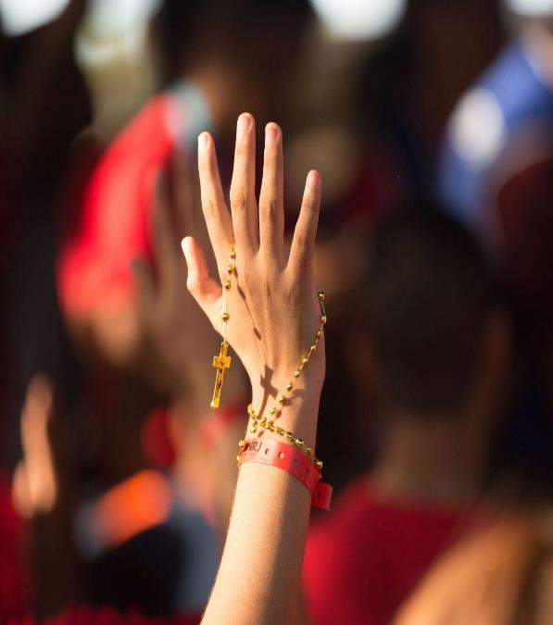
Large Group Feedback & Evaluation
Each facilitator will share a summary of the group discernment to the large group.
  Key messages
  Minority opinions
A written evaluation is provided on the last page of the Participants Guide.
  Collect the evaluations from your table participants.

Slide 12
Closing Prayer
St. Michael Prayer
Saint Michael the Archangel, defend us in battle. Be our protection against the wickedness and snares of the devil; May God rebuke him, we humbly pray; And do thou, O Prince of the Heavenly Host, by the power of God, thrust into hell Satan and all evil spirits who wander through the world for the ruin of souls. Amen.

Slide 13
Thank you!

